Slide 1
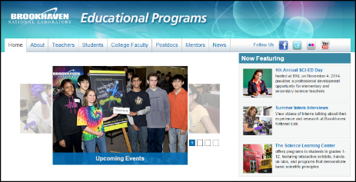
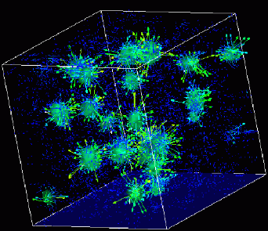

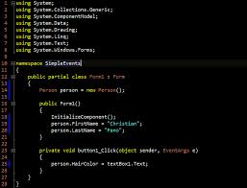
Advanced
Scientific Computing
(SciComp 201)
Session 21
Oblique Projection
Spherical Coordinates

Slide 2
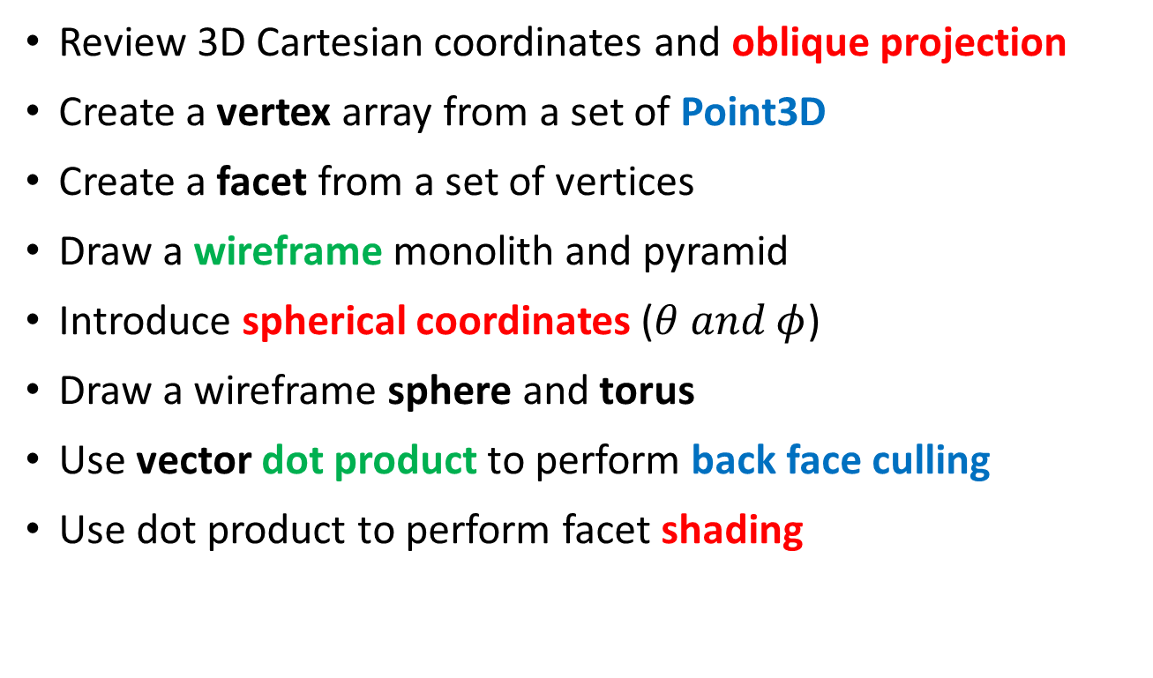
Session Goals
Review 3D Cartesian coordinates and oblique projection
Create a vertex array from a set of Point3D
Create a facet from a set of vertices
Draw a wireframe monolith and pyramid
Introduce spherical coordinates ($θ and φ$)
Draw a wireframe sphere and torus
Use vector dot product to perform back face culling
Use dot product to perform facet shading

Slide 3
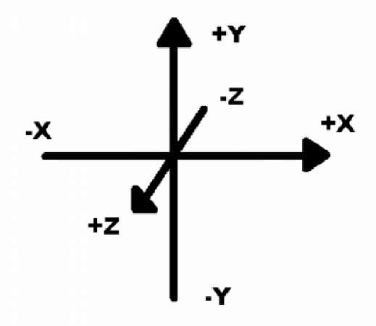
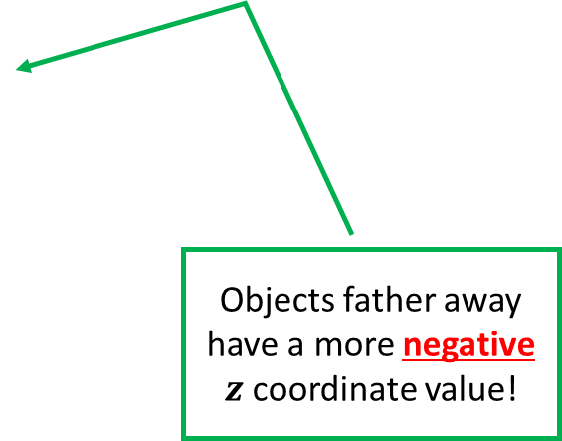
Axis Orientation in 3D
Objects father away have a more negative $z$coordinate value!

Slide 4
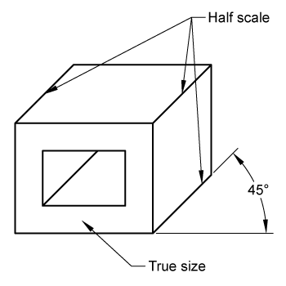
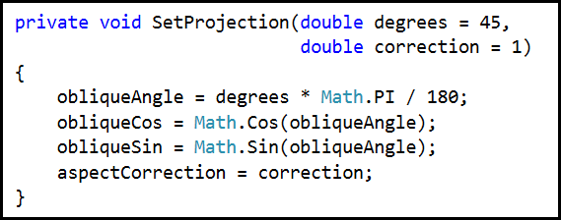
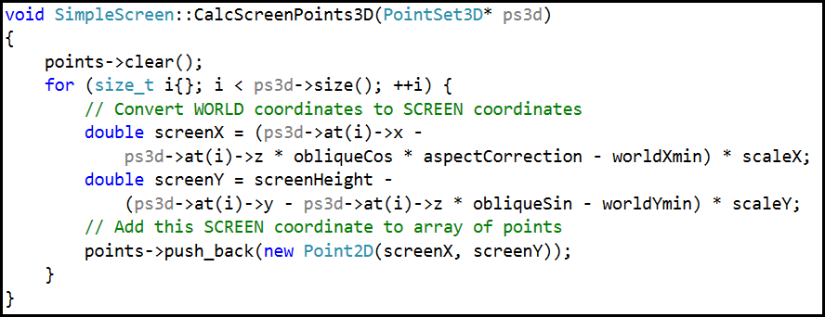
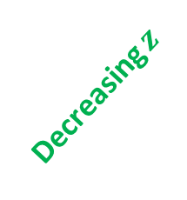
Oblique Projection
Decreasing $z$

Slide 5
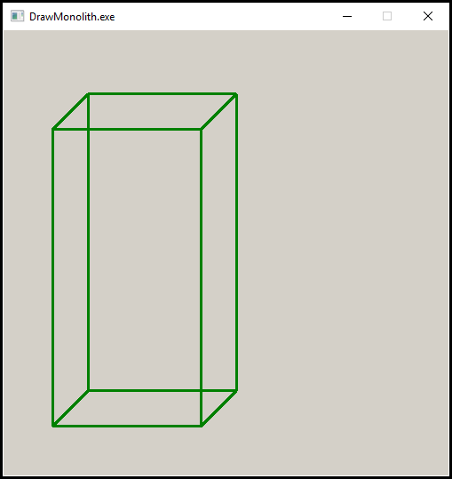
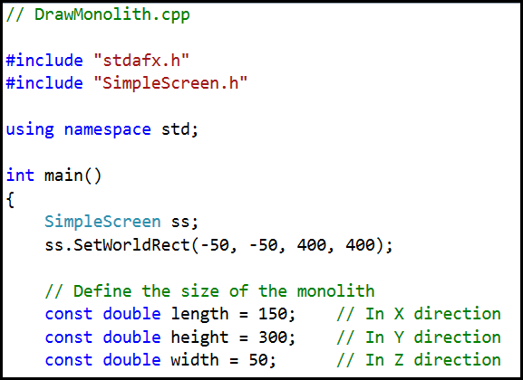
Oblique Projection – Monolith
height
width
length

Slide 6
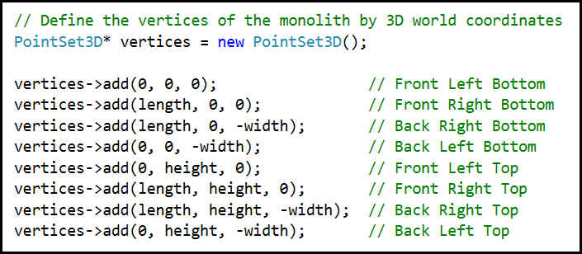
Oblique Projection – Vertex Array
❼
❻
❹
❺
Y+
Z-
❸
❷
⓿
❶
X+

Slide 7
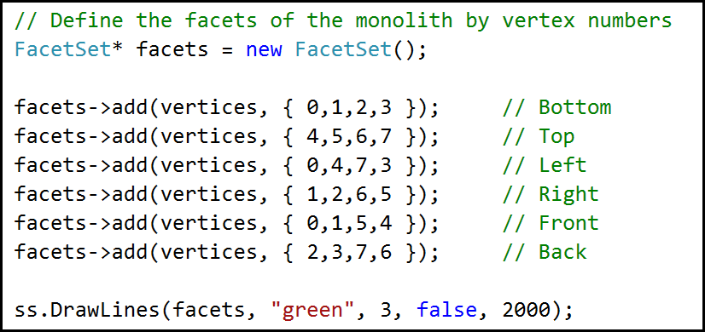
Oblique Projection – Facet Array
Open and run Lab 1
❼
❻
❹
❺
❸
❷
⓿
❶

Slide 8
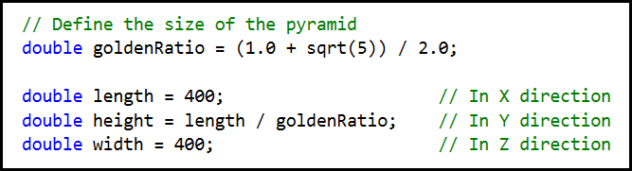
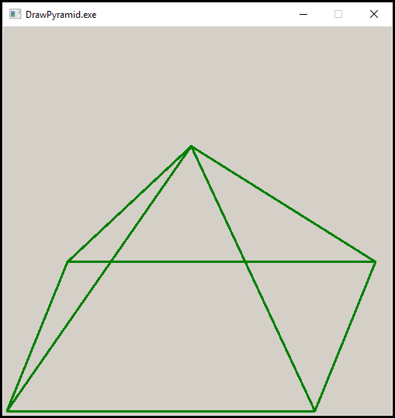
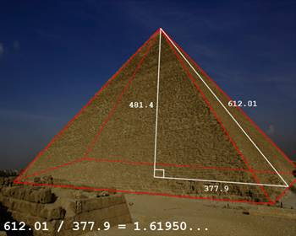
Oblique Projection – Pyramid – Lab 2

Slide 9
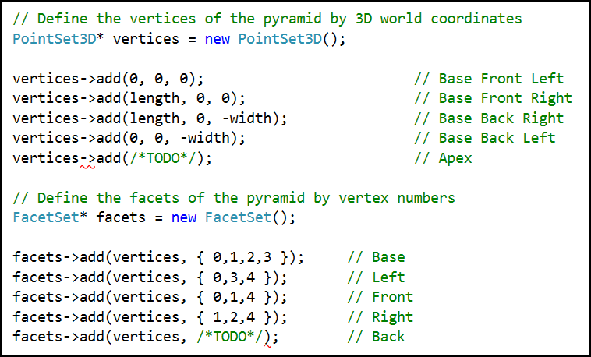
Oblique Projection – Pyramid – Lab 2
Open and edit Lab 2
❹
❸
❷
Remove the two
/* TODO */ comments in the definitions of both vertices and facets, and enter the correct code
⓿
❶

Slide 10
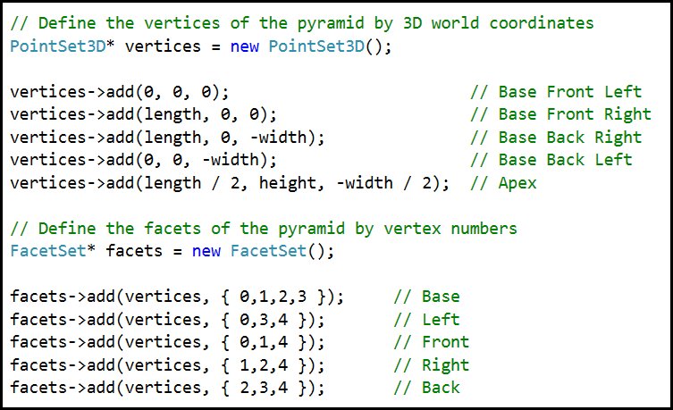
Oblique Projection – Pyramid – Lab 3

Slide 11
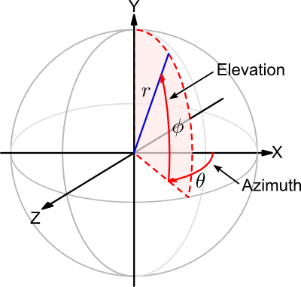
Spherical Coordinates

Slide 12
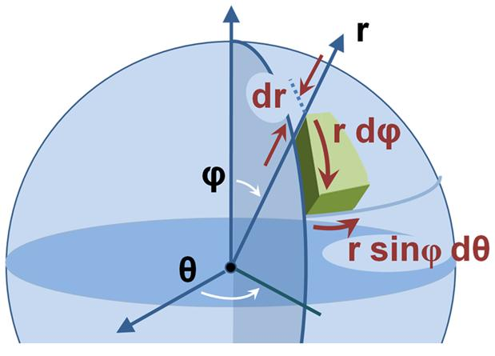
Spherical Coordinates

Slide 13
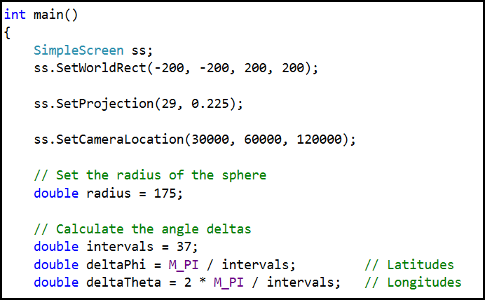
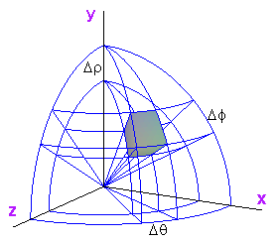
Spherical Coordinates

Slide 14
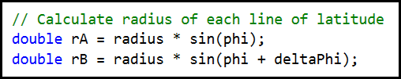
Spherical Coordinates

Slide 15
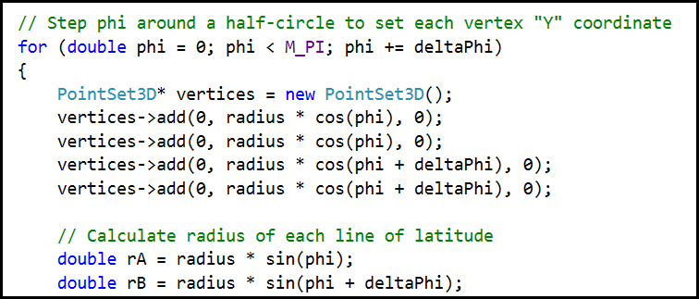
Spherical Coordinates
❶
⓿
❷
❸

Slide 16
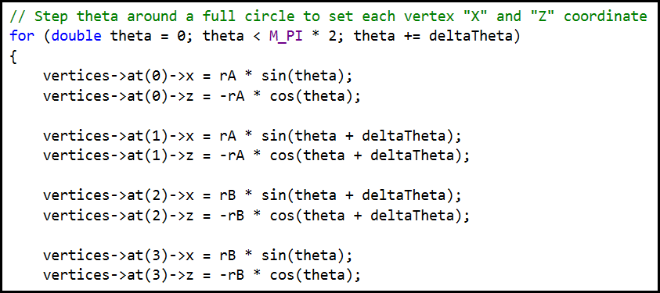
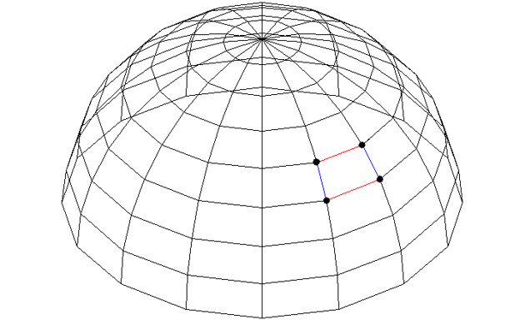
Vertices and Facets
⓿
❶
❸
❷

Slide 17
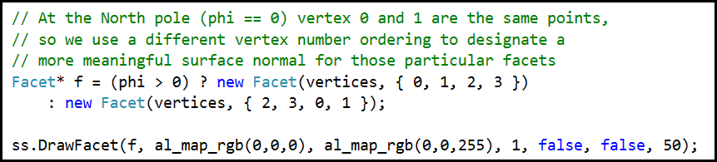
Vertices and Facets
Open and run Lab 3
⓿
❶
❸
❷
RGB Min
RGB Max

Slide 18
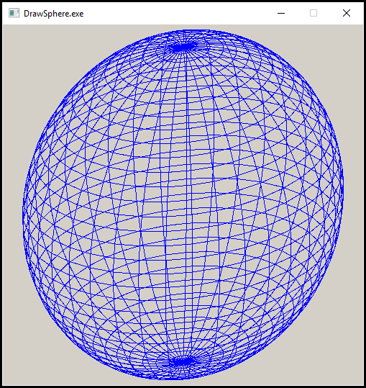
Wireframe Sphere – Lab 3

Slide 19
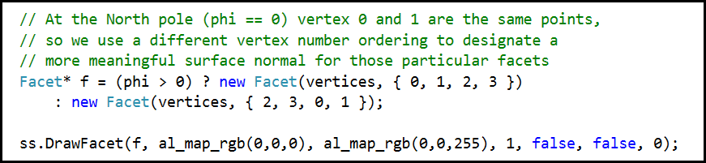
Wireframe Sphere – Lab 3
Re-run Lab 3

Slide 20
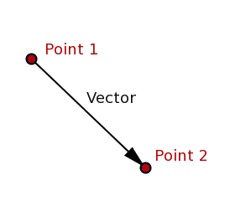
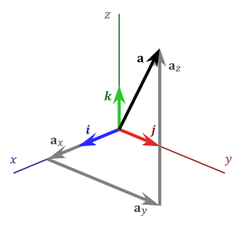
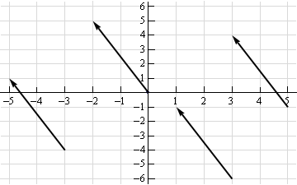
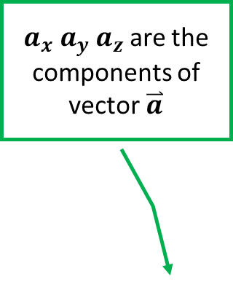
What is a vector?
$a_{x} a_{y} a_{z}$ are the components of
vector$\overset{⃑}{a}$

Slide 21


What is a vector?
$$\overset{⃑}{a}$$
⓿
❶
$$\overset{⃑}{b}$$
❷

Slide 22
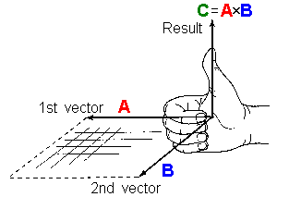
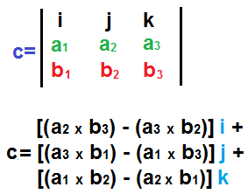
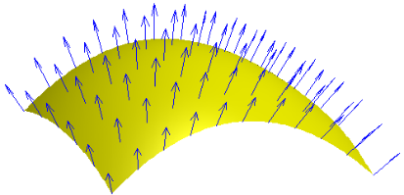
Vector Cross Product
The cross product of two vectors is the determinant of the matrix of their components

Slide 23
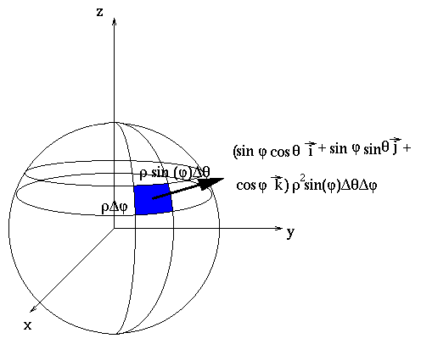
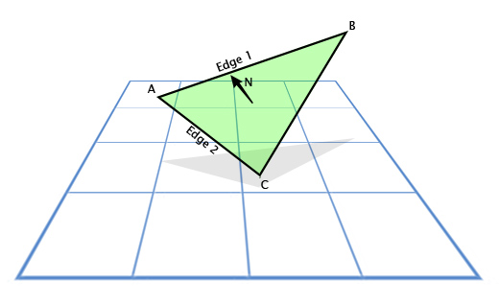
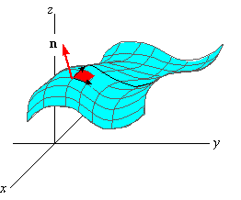
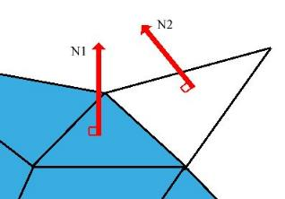
Every Facet has a Surface Normal Vector

Slide 24
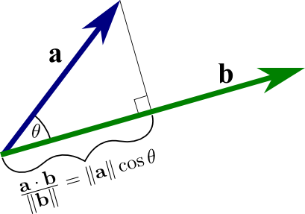
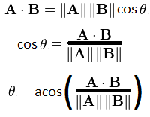
Vector Dot Product
The dot product gives the angle between two vectors

Slide 25
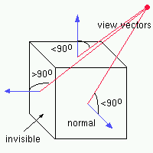
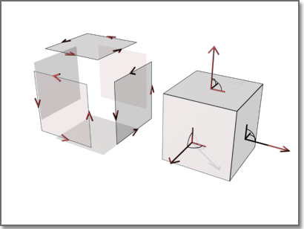
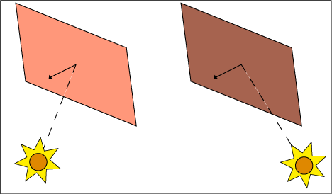
Back Face Culling and Facet Shading

Slide 26
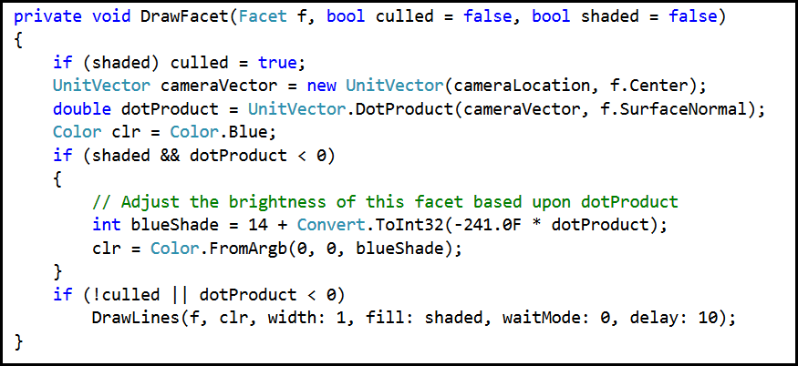
Back Face Culling

Slide 27
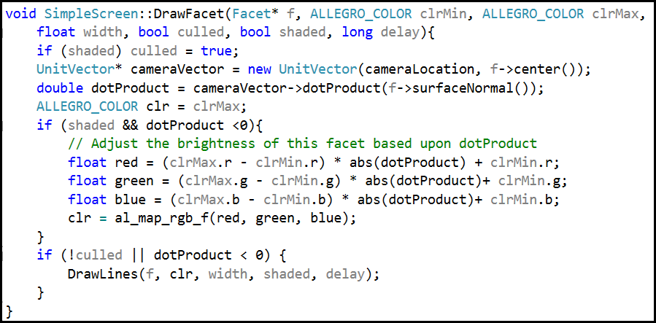
Back Face Culling

Slide 28
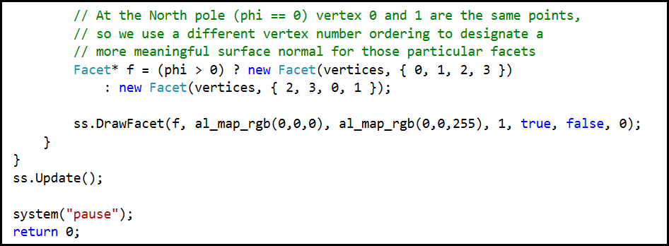
Back Face Culling
Re-run Lab 3

Slide 29
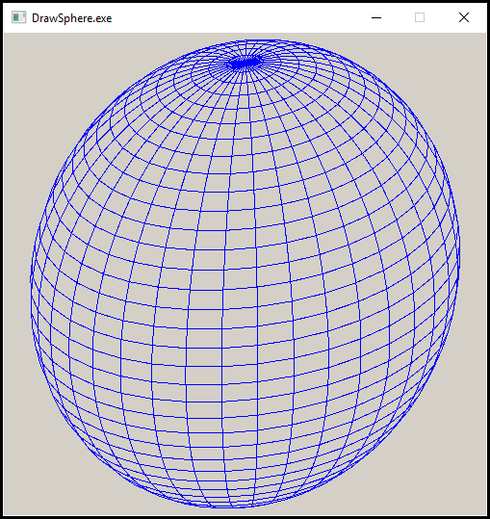
Back Face Culling

Slide 30
Facet Shading

Slide 31

Back Face Culling
Re-run Lab 3

Slide 32

Facet Shading

Slide 33


Drawing a Torus

Slide 34

Drawing a Torus
Open and run Lab 4

Slide 35

Drawing a Torus – Lab 5

Slide 36

Drawing a Torus
Open and run Lab 4

Slide 37

Drawing a Torus – Lab 4

Slide 38
Lab 5 – Draw a Cylinder
Create a new console applications solution
Add NuGet package for Allegro
Select “Primitives” and “Color” add-ons
Select “Dynamic Debug – Dynamic runtime” library type
Copy over stdafx.h, SimpleScreen.h, and SimpleScreen.cpp from “DrawTorus” solution
Add “SimpleScreen.h” and “SimpleScreen.cpp” to project as existing items
Copy statements in main() from DrawTorus
Calculate vertices for each facet, pass to ss.DrawFacet()

Slide 39

So now you know
3D Cartesian coordinates use$\left(x,y,z\right)$ while 3D Spherical coordinates use $(r, θ, φ)$
Oblique projection (2.5D) shows a ¾ “side” view
Sets of vertices are assembled into facets
A surface normal is a cross product using the right-hand rule
A dot product expresses the angle between two vectors
The dot product between the camera vector and each facet normal enables back face culling and facet shading

